Slide 2
ORIENTATION FOR NEW VOLUNTEERS
Welcome to your new role with Southern Maine Agency on Aging (SMAA)
Our orientation is in 4 parts.
Receive your Volunteer Welcome Packet
Watch our orientation video
View this slide presentation to learn more details of the programs and services of SMAA
Take the Survey Monkey Quiz
Now you are ready to VOLUNTEER!

Slide 3
Southern Maine Agency on Aging
AGING AND DISABILITY RESOURCE CENTER
Private nonprofit (501c3)
Geographic service areas (York and Cumberland Counties)
Older Americans Act
Age 55 and up / adults with disabilities
National network of AAA / ADRC’s
Area Agency on Aging/Aging & Disability Resource Centers

Slide 4
WHAT DO WE OFFER?
Up to date information
Family Caregiving Resources
Resource connections
Problem solving
Food Services
Volunteer Opportunities
Partnerships
Adult Day Services
Housing with options
Health promotion
Medicare & Insurance information
Check writing & budget assistance

Slide 5
INFORMATION AND REFERRAL
Aging and Disability Resource Center:
Information on and referral to available services
Health insurance counseling (Medicare)
Family Caregiver Support Program
The Caregiver Respite Program
The Money Minders Program
SOS emergency cell phones

Slide 6
OUTREACH
Professional social workers
Some home visits
Deal with complex situations
Help connect with needed programs
Not a crisis program

Slide 7
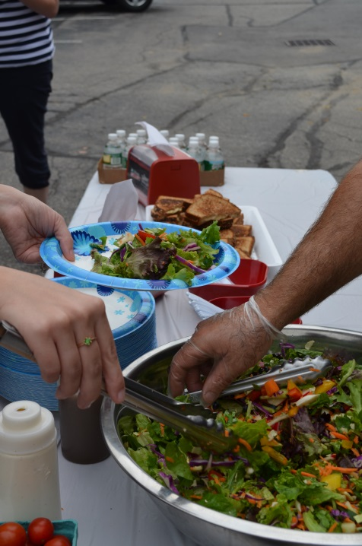
NUTRITION SERVICES
Southern Maine Agency on Aging nutrition services offers four ways to access delicious healthy meals.
Meals on Wheels
“As You Like It”
Community Cafés
Simply Delivered:
Meals Ready When You Are

Slide 8
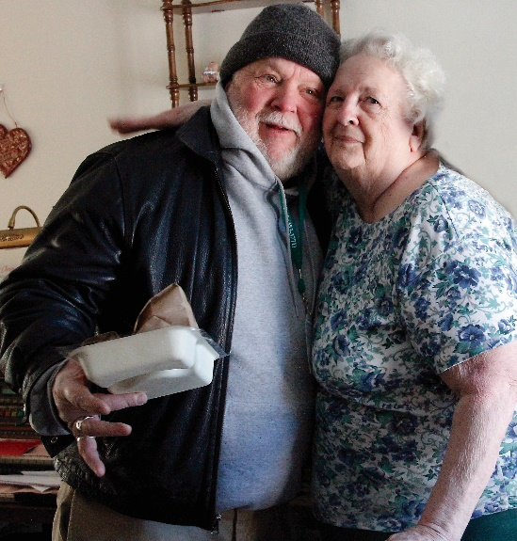
MEALS ON WHEELS
Nutritious home-delivered meals for homebound seniors
Social connection 3 ways - meal delivery, meal heating service, or phone pal volunteers
Qualify for our Meals on Wheels program if you are:
• Age 60 or older; • Primarily homebound or get out with difficulty; • Unable to regularly prepare nutritious meals; • Are home to receive meals during the delivery
time frame; • Agree to an in-home nutritional assessment
(An in-home nutritional assessment will be
completed within 9 business days of the
first delivery to determine full eligibility).
If doesn’t qualify may like to try our Simply Delivered Meal

Slide 9
SIMPLY DELIVERED
Receive up to 7 meals a week, delivered on a convenient day chosen when placing order. Meals will generally be delivered between 10:30a.m.-12:30p.m. on the day of your choice. Simply Delivered meals arrive frozen so can eat them at their convenience and require no additional preparation - 4-5 minutes in the microwave and your meal is ready. (Times will vary by individual microwave.) Simply Delivered meals are available for the low cost of $5.00 per meal, which includes delivery. Meals are purchased in advance. We accept many convenient forms of payment: credit/debit card, cash, or SNAP/food stamps.

Slide 10
“AS YOU LIKE IT”
As You Like It - provides those 50 and over with the opportunity to enjoy a nutritious, delicious meal at a several comfortable dining sites on your schedule. Choose from a comfort food meal like turkey with all the fixings to Maine seafood or stir fry entrees or a chicken Caesar wrap. Most days choices range from an entrée to a soup and sandwich combination. Menus change daily and feature tasty choices. All meals include a low-fat milk and with a small beverage or coffee and choice of dessert.
Dining Locations:
-Blast from the Past -Impressions Cafe
-Blast From the Past Two -Jake’s Seafood
-Bonanza Steakhouse -Mel’s Raspberry Patch (2 locations)
-Brighton Cafeteria -Pearson’s Cafeteria
-Café At the Atrium -Rosa Linda’s Family Restaurant
-Café 84 -York Hospital Dining Room
Register just once!
Must be 60 or older, register once for a free membership card by showing driver's license or other proof of age. Present membership card thereafter and obtain and redeem dining vouchers. Single dining vouchers are available for a suggested donation of $5 per voucher. You may request up to 10 dining vouchers at a time.
.

Slide 11
COMMUNITY CAFES
Community Cafes are available in Biddeford, Kennebunk, Kezar Falls, Kittery/Eliot, Portland, Sanford/Springvale, Scarborough, South Portland, Standish, Westbrook, Windham, and Yarmouth providing an opportunity to socialize with others while enjoying a delicious and nutritious lunch. Some Community Cafes also offer entertainment (such as bingo, games, and musical acts) or educational opportunities (such as speakers and resource tables). Community Cafe Details
Cafes are open to individuals 60 and older.
Initially register for our community cafes by showing your license or proof of age.
Lunch is served at noon.
Café Days vary by location.
Reservations are required
Call the individual cafe 48 hours in advance. If you are unable to attend, please call to cancel your reservation.
Suggested donation is $4 per person for standard meals and $5+ (depending on entrée) per person for catered meals.
Meals are for on-site consumption only.
For participants under 60, or individuals who do not want to register, you may enjoy the meals with us for $7.

Slide 12
HEALTH INSURANCE COUNSELING
Medicare
Medicare D
Medicare Advantage Plans
MaineCare
Low income subsidy
Supplemental insurance
We provide expert unbiased
advice.

Slide 13
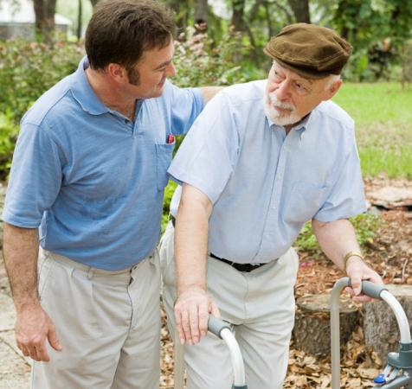
FAMILY CAREGIVER SUPPORT PROGRAM
Support and advice to unpaid family and friends
Care recipient age 60+ or with dementia
Older kinship parents
Information
Support
Education
Access to resources
Respite
Supplemental services

Slide 14
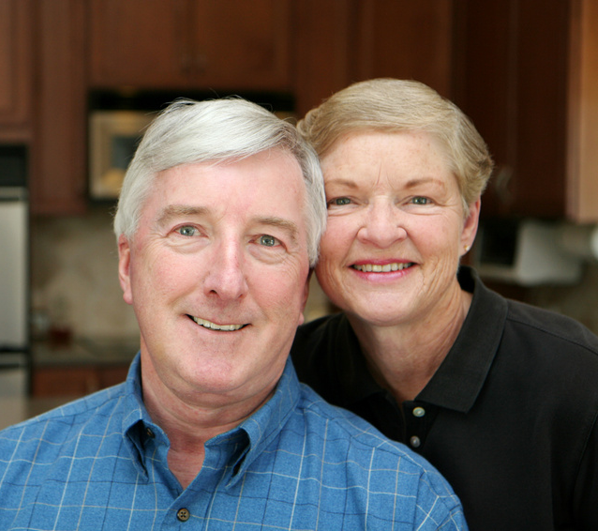
THE CAREGIVER RESPITE PROGRAM
Eligibility requirements
In-home assistance
Adult day program
Overnight in facility
Home adaptation
80% reimbursement up to cap
May be a wait list

Slide 15
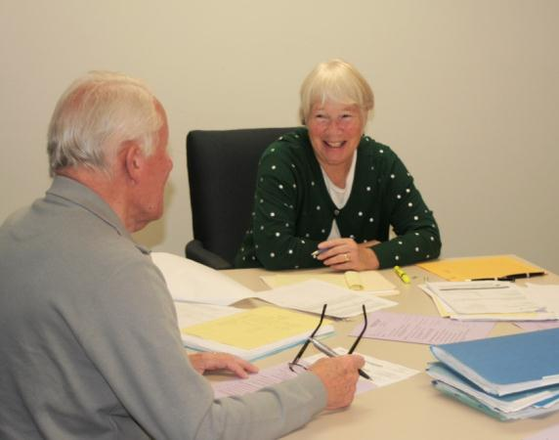
THE MONEY MINDERS PROGRAM
Check writing
Reconciling checkbook with bank statement
Trained, bonded volunteers
Clients retain control over their finances
Work done in clients’ homes

Slide 16
ADVANCE HEALTH CARE PLANNING
Individual counseling and seminars on:
Reflect on values and beliefs
Select a health care decision-maker
Express your wishes
Complete an Advance Directive
Share your wishes and Advance Directive with family and health care providers

Slide 17
COMMUNITY SUPPORT PROGRAM
Serves people with dementia who live alone
Makes home visits to all clients
Often deals with highly complex situations
Creates a comprehensive plan of care that connects the client’s formal/informal supports, and increases the dementia capability of their circle
Friendly volunteer visitors serve as a link between the client and the CSP social workers

Slide 18
ADULT DAY CENTERS
Sam L Cohen Adult Day Center (Saco) - The former Truslow Center has relocated to Biddeford after 30+ years and been rededicated as the Sam L Cohen Center in 2016. Hours are Monday through Friday from 8:00a.m.-5:00p.m.
Stewart Adult Day Center (Falmouth) - Hours are Monday through Friday from 8a.m.-5p.m. Some weekend and evening programs and events. Drop-in hours are available - conditions apply.
At each center person-centered activities are designed to honor and engage the individual in ways that will be fun, stimulating, and interesting.
Activities offered during a typical day at the Day Centers might include:
• Arts and crafts • Pet therapy • Music, song, and dance • Gardening
• Story-telling • Woodworking • Baking • Jigsaw puzzles/word-search games

Slide 19
AGEWELL WORKSHOPS
Living Well for Better Health and Chronic Pain Self-Management
Living Well for Better Health (also known as the Chronic Disease Self-Management program) is a 6-session workshop designed to help people with chronic health issues learn about different "tools" or techniques to manage their symptoms, improve their health, and start living a more fulfilling life. Participants and trained leaders meet once a week for 2.5 hours each session to discuss various strategies to become proactive self-managers of one's own health.

Slide 20
AGEWELL WORKSHOPS
A Matter of Balance
A Matter of Balance is a nationally recognized program designed to reduce the fear of falling and encourage physical activity. The workshop is conducted over eight sessions, meeting weekly or twice weekly for two hours per session. Meetings are led by trained volunteer leaders. Participants learn to:
• View falls as something they can control
• Set goals and increase their activity levels • Make changes around the home to reduce fall risks
• Exercise to increase strength and balance • Become proactive self-managers in reducing their own risk for
falls

Slide 21
AGEWELL WORKSHOPS
Tai Chi for Better Health and Balance
Tai Chi is a low-impact exercise that works well for older adults because it is performed in slow, fluid movements which puts minimal stress on bones and joints. Tai Chi can be done seated or standing, which allows for people to participate at their own ability level. Tai Chi has been shown to prevent falls by:
• Improving balance • Increasing leg strength
• Reducing fear of falling • Improving mobility
• Increasing flexibility • Improving psychological health

Slide 22
MAINE SENIOR GAMES
Maine Senior Games hosts annual athletic and wellness events for adults over the age of 45. 2017 marks MSG’s 31st senior games which run June through October.
Eligibility and Age Groups The Maine Senior games is open to anyone 45 years of age or older. Competition will be held in the following 13 age groups for men and women. Age group placement is determined by your age as of December 31 of the current game's year. Age groups are as follows: 45-49, 50-54, 55-59, 60-64, 65-69, 70-74, 75-79, 80-84, 85-89, 90-94, 95-99 and 100+.
Events Include
Archery, basketball, candlepin bowling, ten pin bowling, cycling, golf, horseshoes, pickleball, racquetball, men’s softball, swimming, table tennis, triathlon, tennis, track and filed, 5K/10K road races, hot shot/foul shot and others as added.
Awards Medals are presented to the top three places and a ribbon for fourth place. Awards will be presented as soon as results are posted and/or announced at each event, or may be picked up at the Maine Senior Games office during the week following the event.

Slide 23
VOLUNTEER OPPORTUNITIES
For Volunteers 55 and Older The Retired and Senior Volunteer Program (RSVP) is part of the Corporation for National Community Service's (CNCS) SeniorCorps. RSVP acts as a clearinghouse, connecting volunteers to positions at dozens of nonprofits throughout Cumberland and York counties.
For Volunteers of All Ages Southern Maine Agency on Aging with its many programs relies on volunteers to provide services to the thousands of older adults in need of assistance each year. Occasional assignments a few hours a month or assignments to keep busy every week can be found at SMAA.

Slide 24
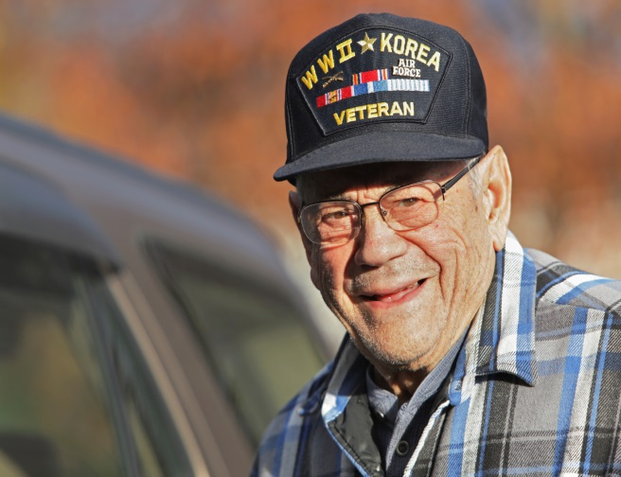
VET TO VET: VETERANS HELPING VETERANS
Vet to Vet matches a homebound or disabled veteran with a volunteer who is a veteran for peer contact and visitation.
The veteran receives:
Visits from a trained veteran volunteer
At least 2 visits a month
Companionship of a fellow veteran
Referral for services if needed

Slide 25
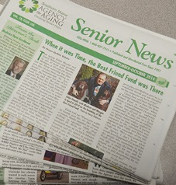
OTHER RESOURCES
Check out SMAA’s website at www.smaaa.org
Visit us on Facebook as well
Sign up to receive the Senior News

Slide 26
THANK YOU
You are now ready to take the Quiz and begin volunteering!

